Slide 1
Rebecca Clarke
17032866

Slide 2
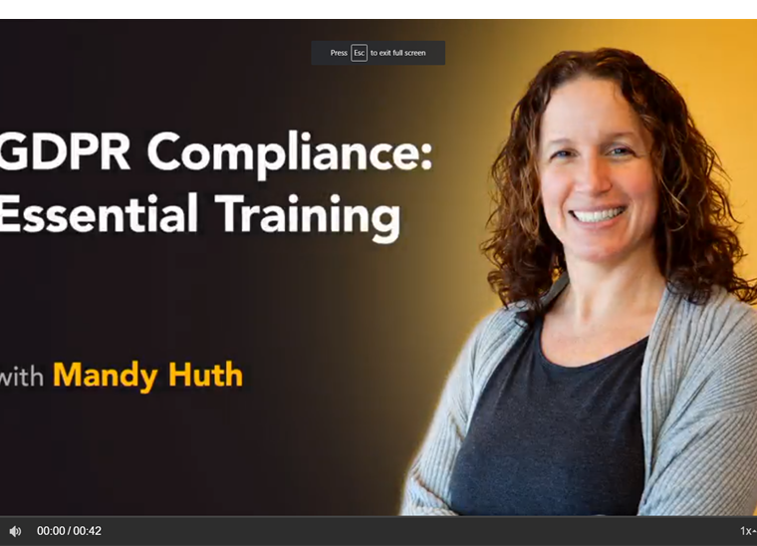
GDPR Compliance Training
The activity I undertook was a GDPR Compliance Essential Training video, I was trying to achieve an understanding of what GDPR was and how it was important within the law. I felt very curious about how this law could be used within day to day life and how It will affect different organizations, I learned that GDPR is general data protection regulation and it’s a new law which has new principles for the collection and processing of personal information. The new law means businesses have to be clearer about how they are collecting peoples personal data and how they are going to be using and storing it. From this activity I am going to be using specific methods to keep data safe, making sure I am going to be encrypting data and when collecting data in the future making sure I am informing people how their data will be collected and used as well as making sure this data is stored correctly, for example, making sure its encrypted. Learning about this is enabling me to make sure I follow the correct law and procedures in the future.

Slide 3
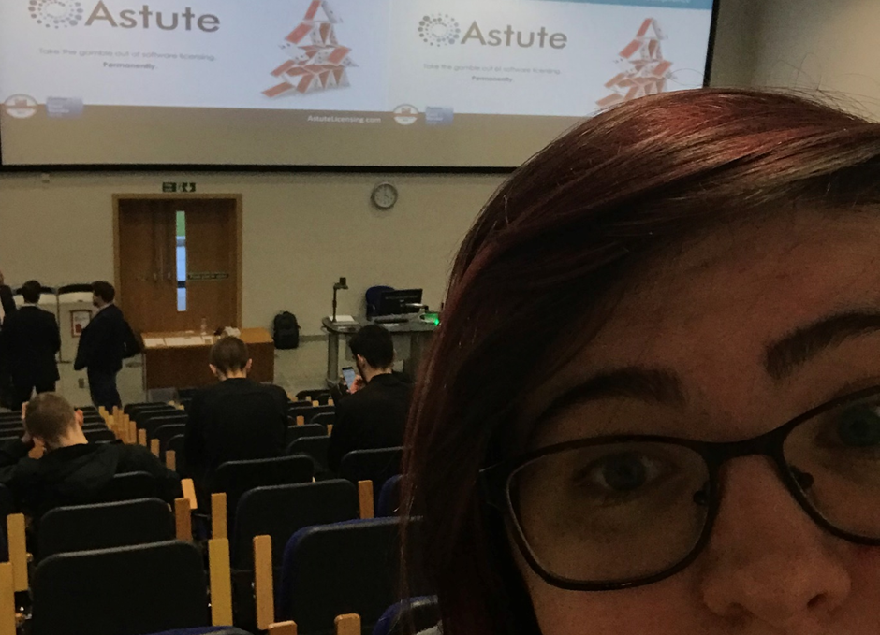
Why Process is key to good ITAM
The activity was a presentation delivered by Astute on why process is key to good ITAM. Astute delivered a presentation on this however I feel the presentation was aimed more at professionals due to the fact they used complicated language and acronyms and didn’t explain fully what these meant, so I felt very confused throughout the presentation, I did, however, enjoy listening to the case study's which showed what the challenges they had with license compliance. I feel I could have improved my understanding of the presentation and what they were speaking about with researching what ITAM was before going. My action plan going forward for future events like these is to research the topic beforehand so I don’t feel excluded when they are explaining and I can understand what they are speaking about.

Slide 4
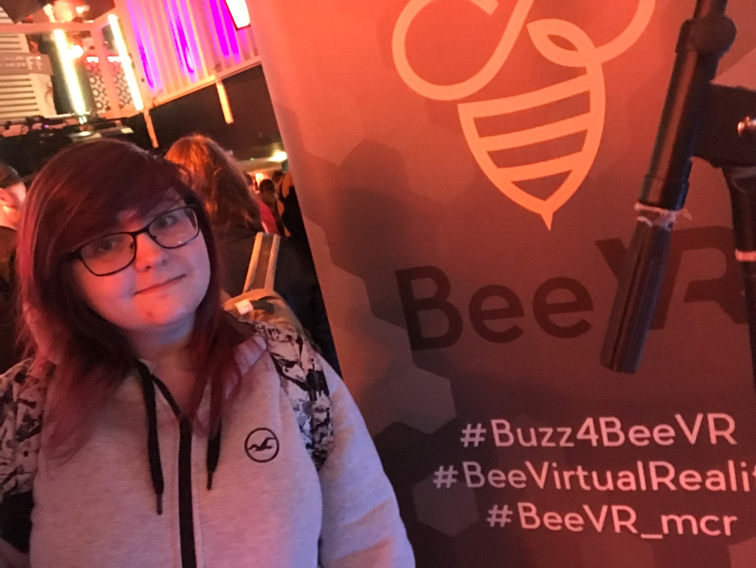
Manchester Gamers Unite
The activity I went to is a showcase of game companies showing off their work, I undertook some demos of their games. I tried to understand how they programmed the game and what key aspects are similar throughout. One of the anxieties I felt during this was the busyness as well as the courage to ask questions, I think I overcame this by starting with a compliment and general conversation and after this asking them the questions I had regarding the structure of the game. I could try and write down questions I wanted to ask to make sure I got answers to them as well because I forgot to ask several questions as going at a less busy time or trying to take a moment out and go back and resume the activity. I got a lot of good responses and following the conversations I now know about the different amount of teams which are involved in making a game and how I would personally get involved in applying for a job and what would be required of me if I applied for a programming job-making games. From this activity I have gained a motivation to do programming to see a working end result, I have also learned from general conversation to not be afraid to make mistakes as the games have gone through several versions to make them what they are now. I plan to have conversations with friends and tutors one on one regarding questions I have to try and help build up the confidence to help my anxiety to ask questions during lectures or events.

Slide 5

Meet The Employers
The employability and placement event I went to had several companies which offered placements, I went to this event with the hope to learn more about how a placement could help me during the future and how placements could help improve my skills. We had a limited time at each table to ask questions and learn about what placement options they offer, several other people asked questions and therefore I didn’t have time to ask my questions, I could have been more confident and pushed to ask my question instead of letting other people ask questions before me, I felt nervous at the time asking questions and this is why I let others ask before me. In situations like this, I need to be driven to ask my questions and not let others overshadow me because I am nervous asking questions. From this activity I know how to apply for placements however due to the several employers explaining this while talking about the placements they offer, moving forward I am going to try and develop myself in several areas employers are looking for within placement students such as teamwork, I am going to be doing this by undertaking a more significant role within teamwork tasks moving forward.

